Slide 1



Anime
Recommendation System: A Data- Driven Approach
In the vast and ever-expanding world of anime, finding the perfect show to watch can be a daunting task. With thousands of titles available across various genres and themes, navigating this landscape can feel overwhelming. This presentation delves into the creation of an anime recommendation system that leverages the power of data warehousing and datamining techniques to provide personalized recommendations tailored to individual preferences.
by HARSHAVARDHAN GOWD

Slide 2
Importance of Datawarehousing in Anime Recommendation
Centralized Data Repository
Data warehousing plays a crucial role in anime recommendation systems by providing a centralized repository for storing vast amounts of data related to anime titles, user preferences, and viewing history. This centralized structure allows for efficient data access and analysis, which are essential for building accurate and personalized recommendations.
Data Integration and Consistency
Data warehousing ensures data consistency and integrity by integrating data from various sources, such as user reviews, streaming platforms, and anime databases. This unified view of data allows for a holistic understanding of user preferences and anime characteristics, leading to more accurate recommendations.
Historical Data Analysis
Data warehousing enables the analysis of historical data, such as user viewing patterns and trends in anime popularity. This historical analysis provides valuable insights into user behavior and emerging trends, which can be utilized to enhance recommendation accuracy and relevance over time.

Slide 3

Data Collection and Preprocessing
1
Data Collection
The first step in building an anime recommendation system is collecting data from various sources. These sources can include streaming platforms like Crunchyroll and Netflix, anime databases like MyAnimeList, and user reviews from online forums.
Data Cleaning
Once data is collected, it needs to be cleaned to ensure accuracy and consistency. This involves handling missing values, removing duplicates, and standardizing data formats to ensure data integrity and reliability.
2
Data Transformation
Data transformation involves converting raw data into a format suitable for analysis. This may involve normalizing data values, creating new features, or aggregating data to provide meaningful insights for recommendation algorithms.
3

Slide 4
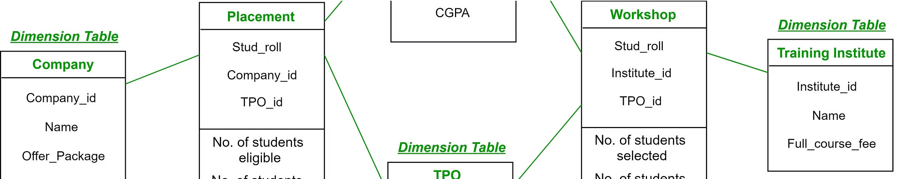
Dimensional Modeling for Anime Data
Fact Table
The fact table is the central component of a dimensional model, containing numerical data about anime views, user ratings, and other relevant metrics. This table is linked to various dimension tables, providing context and details for the fact data.
Dimension Tables
Dimension tables contain descriptive attributes about the data in the fact table.
For example, a dimension table for anime might
include attributes such as title, genre, release date,
and studio. Dimension tables provide rich context and facilitate data analysis.
Star Schema
The star schema is a popular dimensional modeling approach where the fact table is at the center, connected to multiple dimension tables. This structure provides efficient data retrieval and analysis, making it ideal for recommendation systems.

Slide 5
Fact Table and Dimension Tables
Fact Table
Dimension Tables
AnimeID
Anime: AnimeID, Title, Genre, ReleaseDate, Studio
UserID
User: UserID, Age, Gender, Location
Rating
Rating: RatingID, RatingValue
ViewCount
Platform: PlatformID, Name, Region

Slide 6
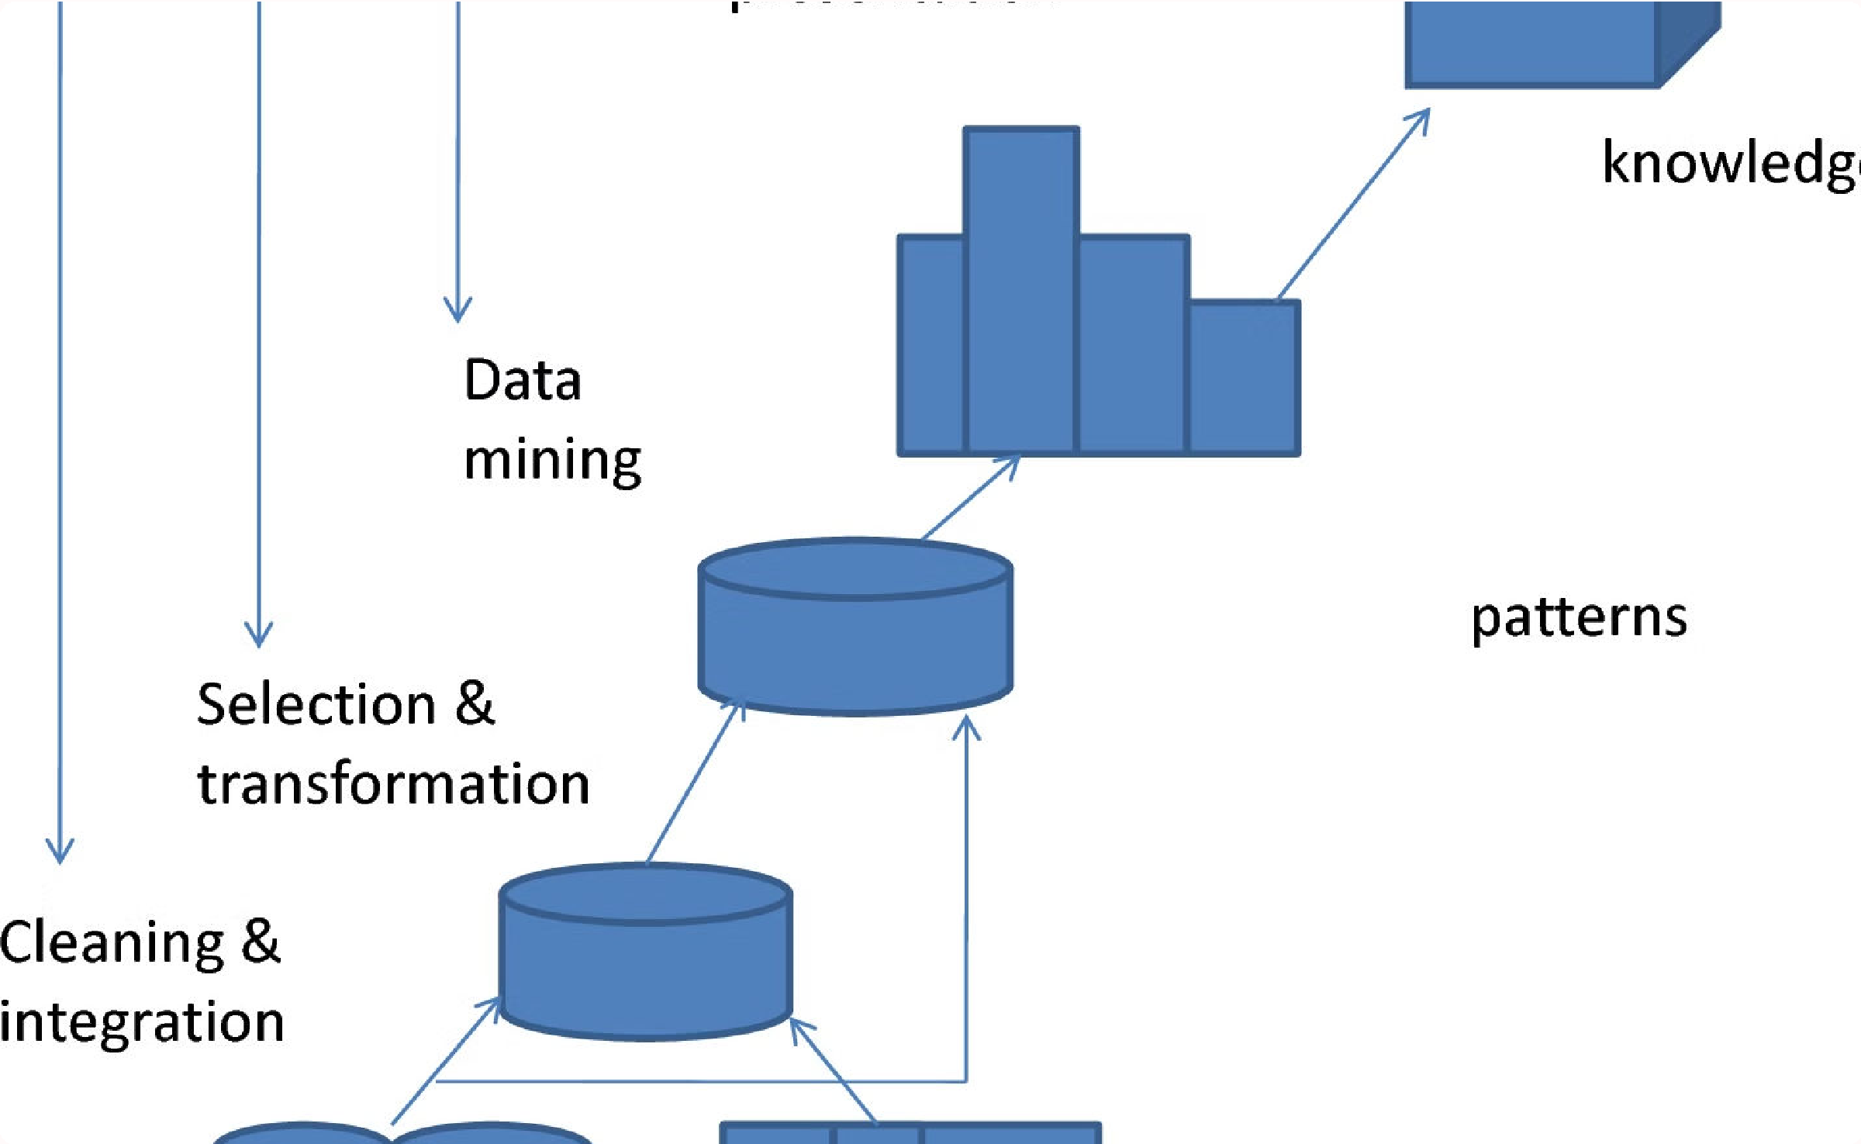
Datamining Techniques for Recommendation
1
Collaborative Filtering
Collaborative filtering analyzes user behavior and preferences to identify similar users and recommend anime based on their shared tastes. This approach relies on the principle that users who liked similar anime in the past are likely to enjoy similar anime in the future.
2
Content-Based Filtering
Content-based filtering analyzes the characteristics of anime titles, such as genre, plot, and characters, to recommend similar anime based on a user's past preferences. This approach focuses on the content of anime and provides recommendations based on similarities in themes and styles.
3
Hybrid Recommendation
Hybrid recommendation systems combine the strengths of collaborative filtering and content-based filtering to provide more comprehensive and accurate recommendations.
These systems leverage both user behavior and content characteristics to identify relevant anime suggestions.

Slide 7

Collaborative Filtering and Content- Based Filtering
Collaborative Filtering
Collaborative filtering algorithms use user-item interactions to create recommendations. They identify users with similar tastes and recommend
1
items that those similar users have enjoyed. For example, if two users have rated a specific anime highly, the system might recommend another anime that both users have rated highly.
Content-Based Filtering
Content-based filtering algorithms recommend items based on their similarity to items that a user has liked in the past. This approach analyzes the features of the items, such as genre, director, or actors, and recommends items with similar features.
2
Hybrid Approach
Hybrid recommendation systems combine both collaborative and content- based filtering techniques to provide more accurate and personalized recommendations. They can leverage user behavior and item characteristics to create a more comprehensive understanding of user preferences.
3

Slide 8
Deployment and Evaluation of the Recommendation System
Evaluation Metrics
The recommendation system's performance is evaluated using metrics such as precision, recall, and F1-score. These metrics measure the accuracy and relevance of recommendations, ensuring that the system provides valuable and relevant suggestions to users.
User Feedback
User feedback is crucial for continuous improvement. Incorporating user feedback, such as ratings and reviews, allows for fine-tuning the recommendation algorithm and ensuring that the system meets user expectations.
Deployment and Scalability
The recommendation system can be deployed on a cloud platform, providing scalability and accessibility to a wide range of users. This allows for real-time recommendations and ensures that the system can handle the growing demand for anime content.

